Slide 1

Taxi Fare Prediction

Slide 2
Teamwork:

Slide 3

AGENDA
Objective

Slide 4
A taxi goes Chinatown to times square how long will it take to arrive?
--------------------------------------------------------

Slide 5

Objective

Slide 6
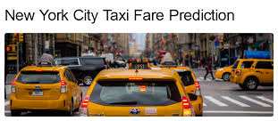
The objective of New York taxi fare prediction is to develop a model that accurately predicts the fare amount for taxi rides specifically in the context of New York City. The primary goal is to estimate the fare cost based on various input features related to New York taxi trips

Slide 7
Taxi challenge
Data:
In this challenge you are given data on taxi rides in new York containing information on each ride such as the start and end points ,data, time of day , distance , etc
Goal:
Our purpose is to predict travel time(in logarithmic scale) of a ride.
The data is spilt to train and test sets ,and we can use both general data of the ride with local data on similar rides from the train sets.

Slide 8
fare_amount:
Description: The fare amount charged for the trip.
Role: This is the dependent variable or the target variable that the model will predict based on the various input features provided in the dataset.
Type of Problem:
The New York taxi fare prediction problem is a regression problem. In machine learning, regression problems involve predicting a continuous target variable based on one or more input features. In this case, the target variable is the fare_amount, which is a continuous numerical value representing the fare charged for each taxi trip
.

Slide 9
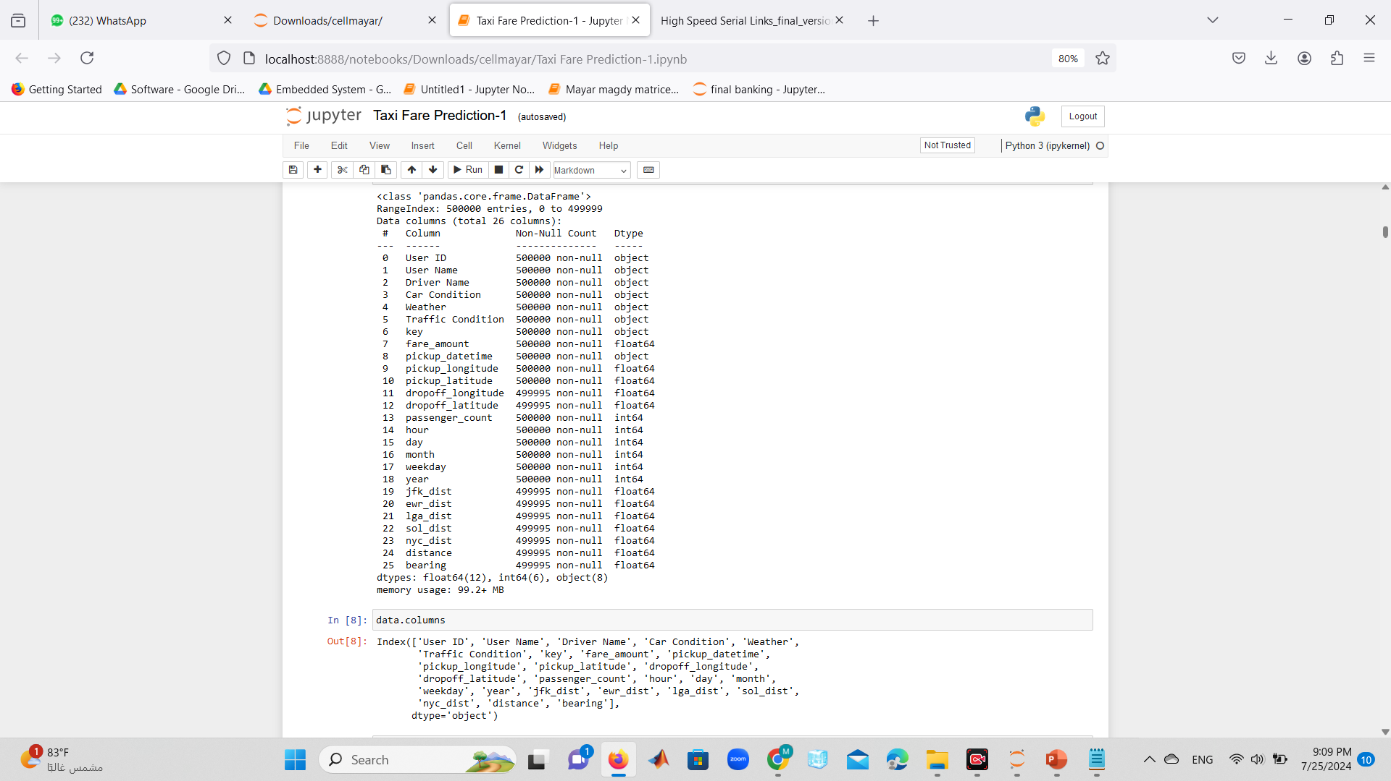
Missing value

Slide 10
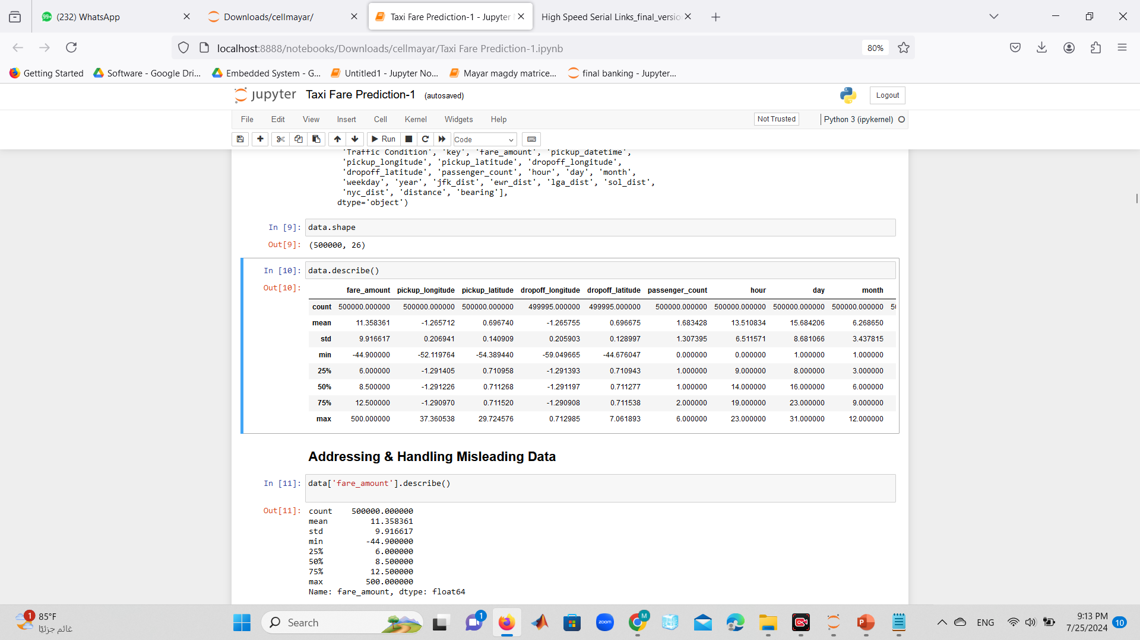
Data describe:

Slide 11
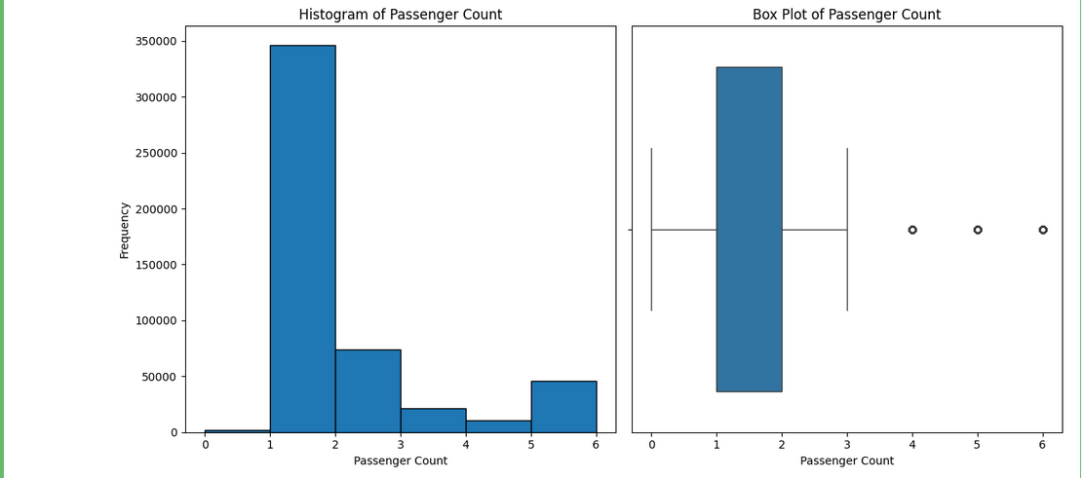
histogram of passenger count:

Slide 12
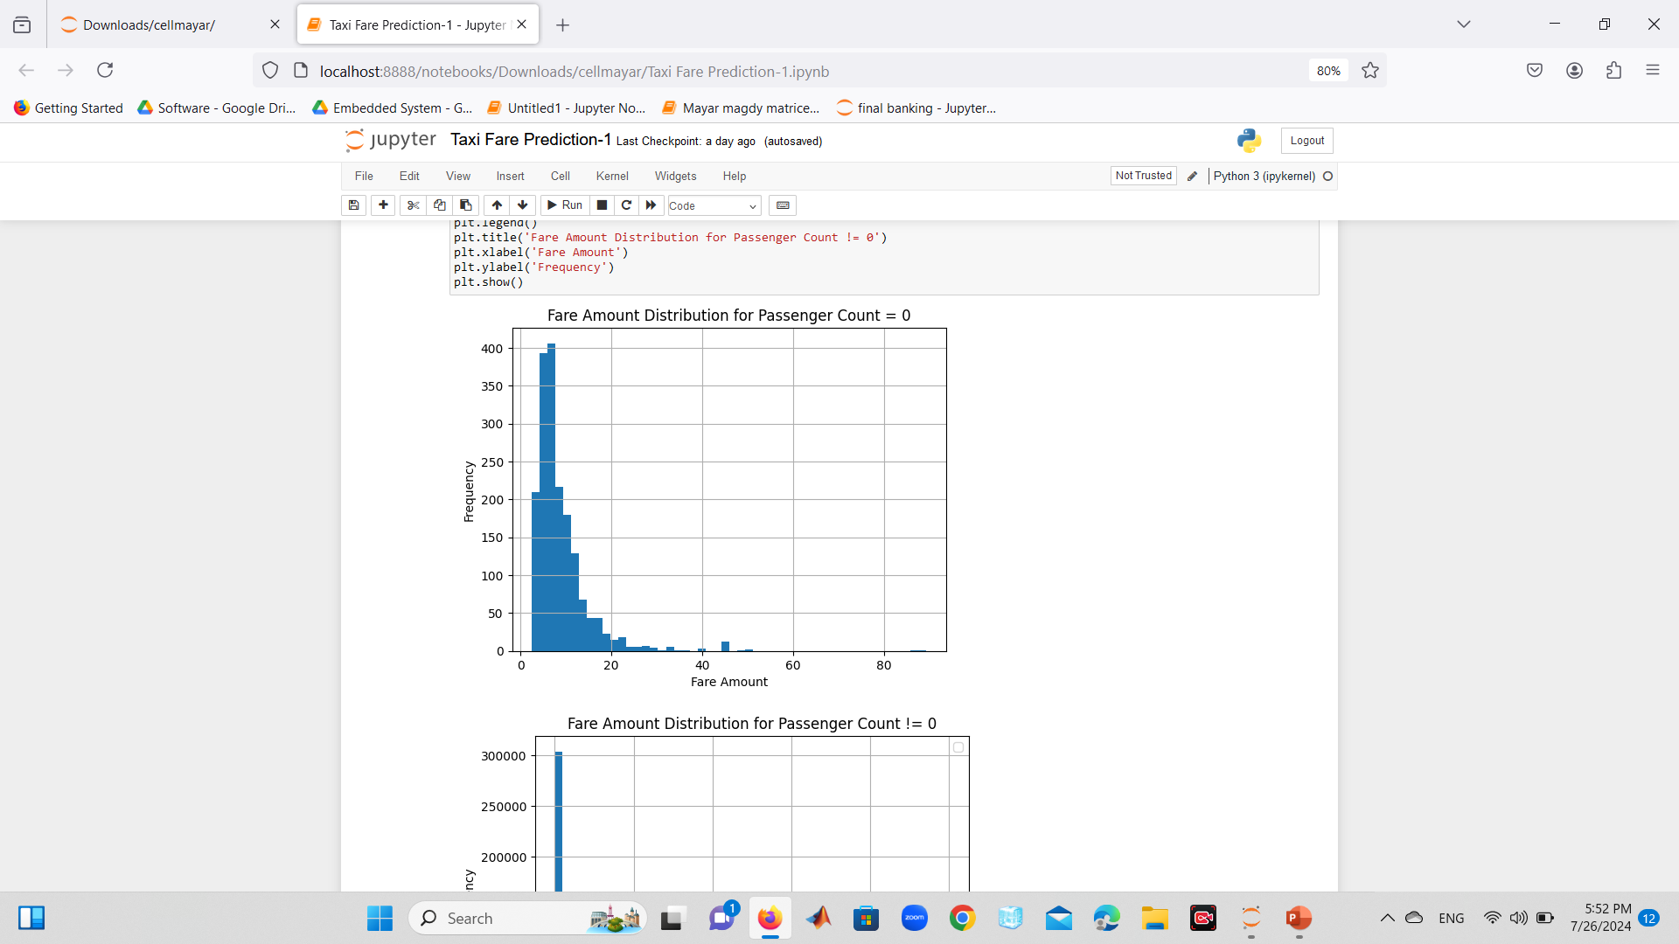
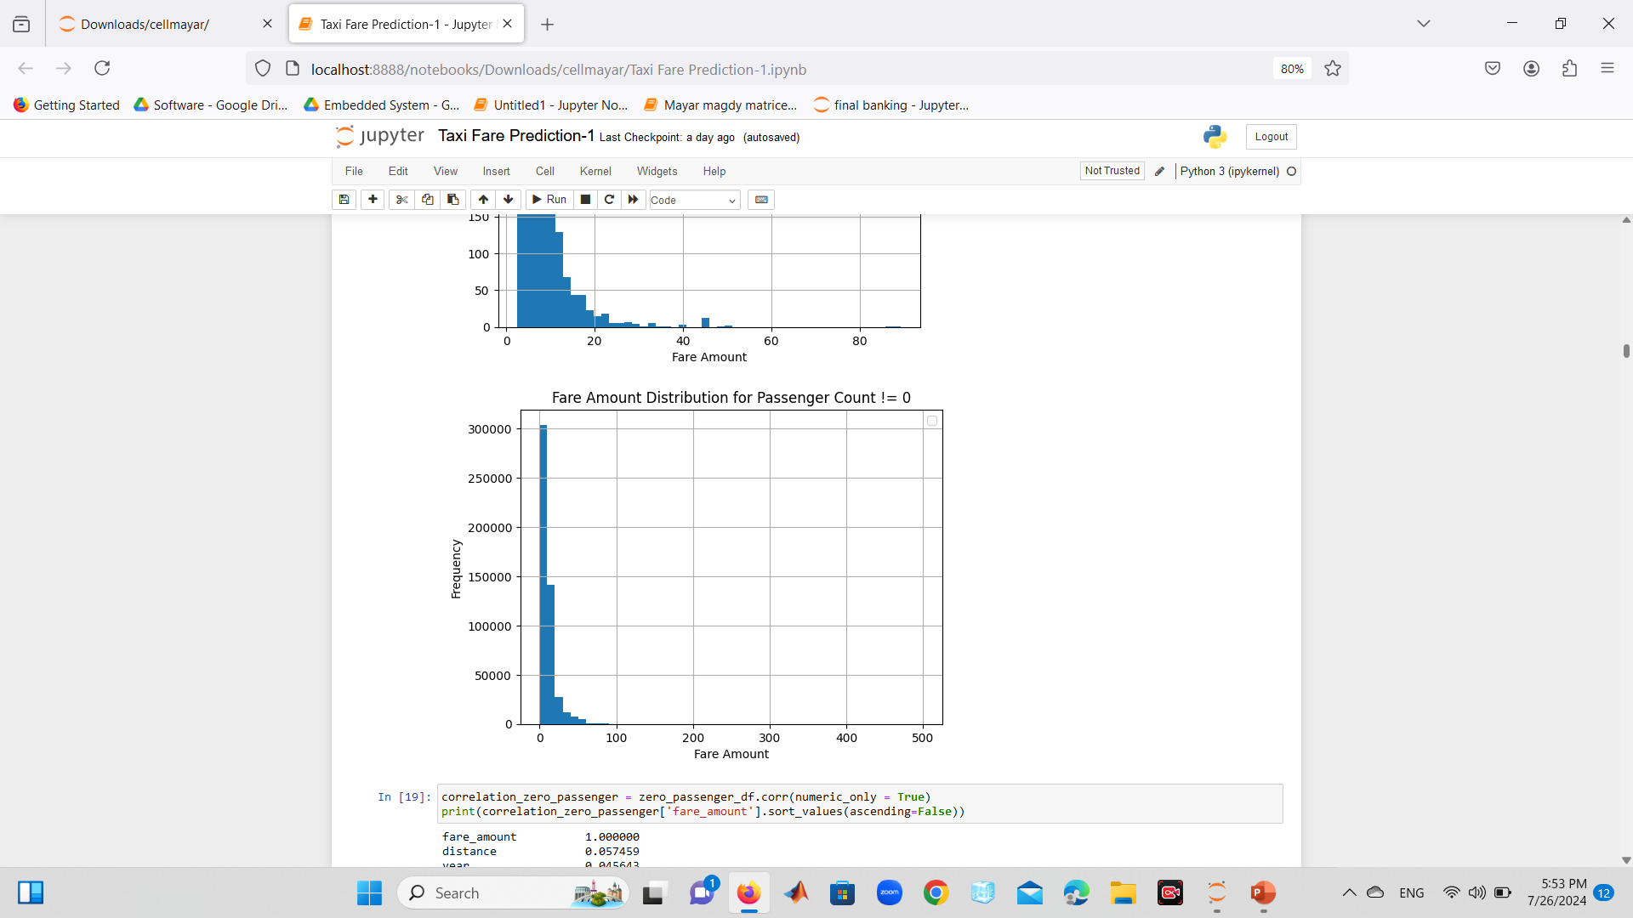
fare amount &frequency:

Slide 13
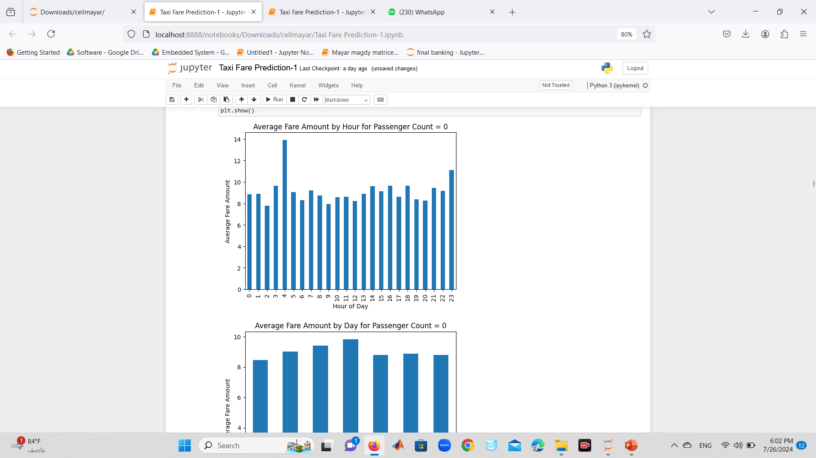
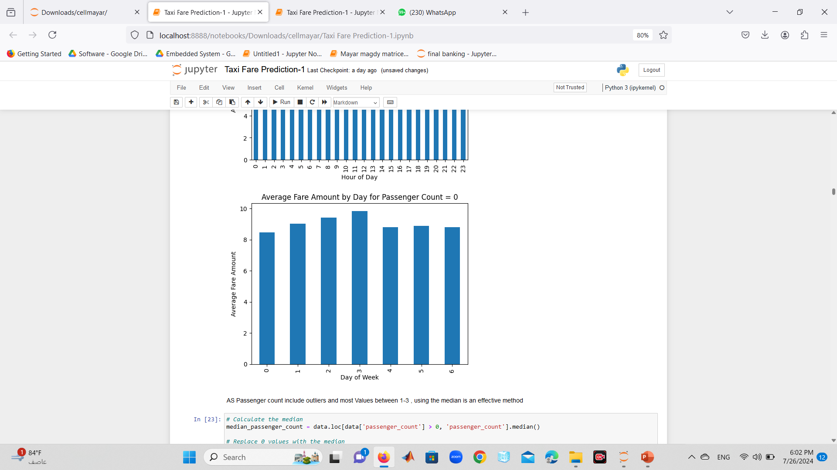
average fare amount &hour of day :

Slide 14
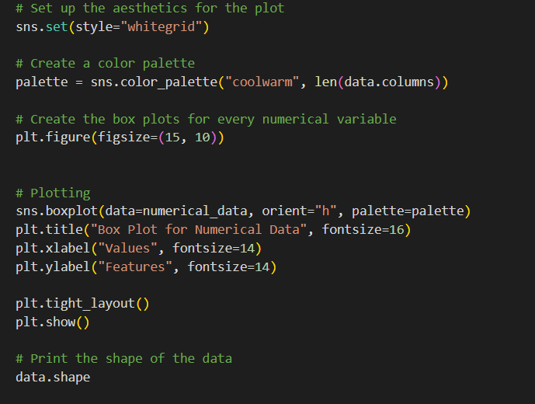
Data CLEANsiNG:

Slide 15
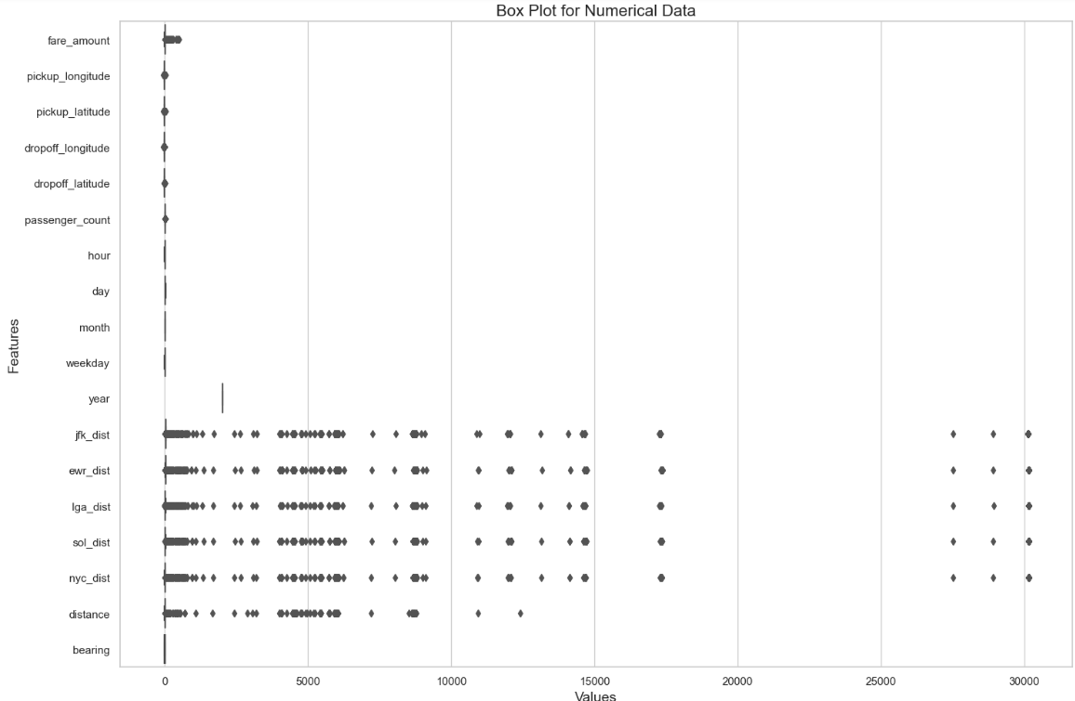
Data CLEANsiNG (cont):

Slide 16
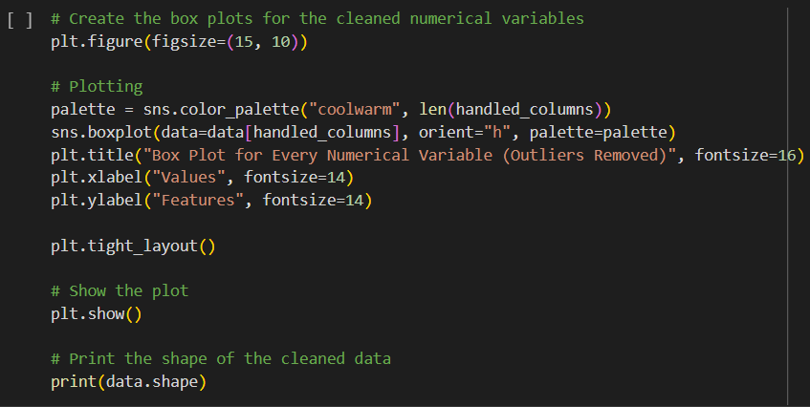
Data CLEANsiNG:

Slide 17
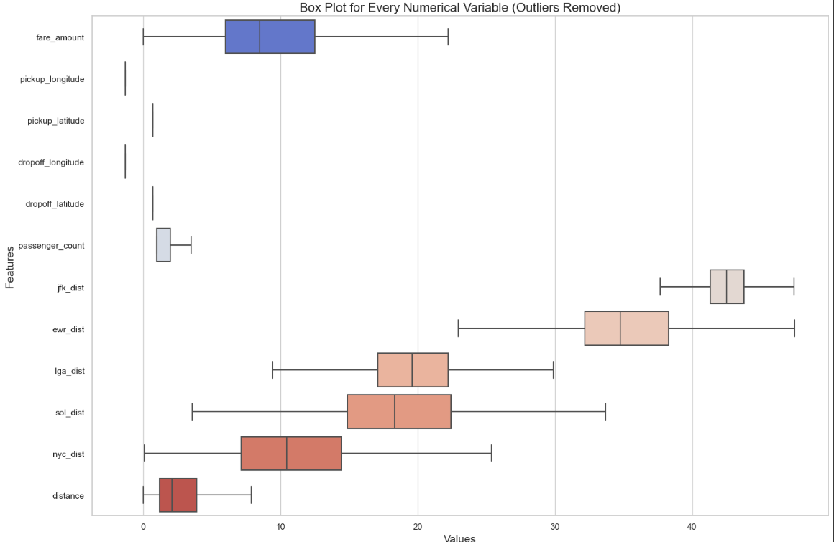
Data CLEANsiNG:

Slide 18
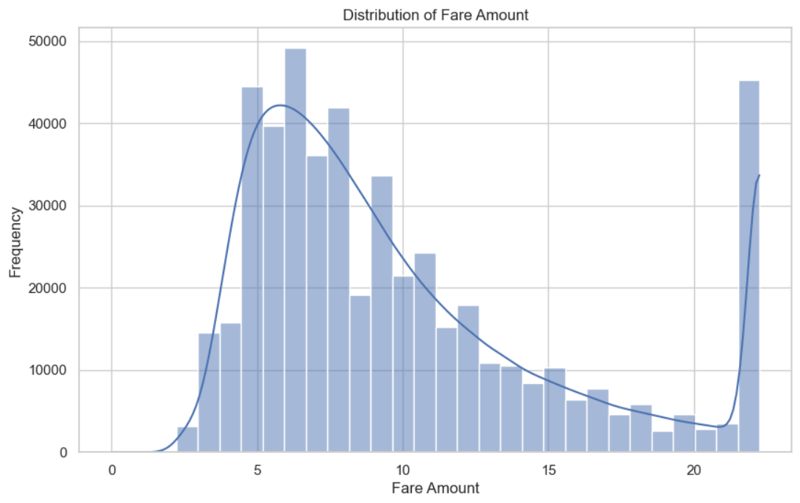
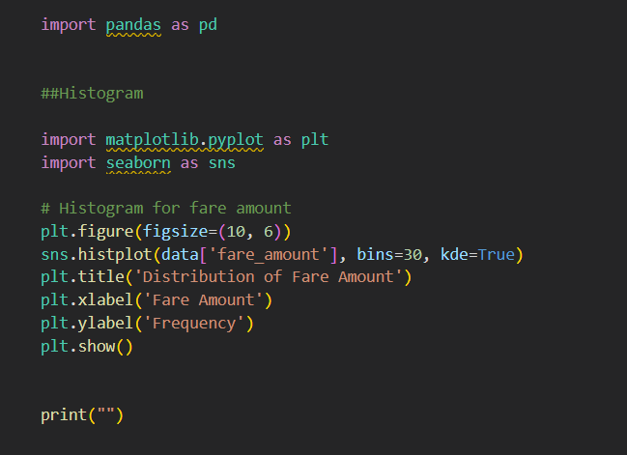
Data CLEANsiNG:

Slide 19
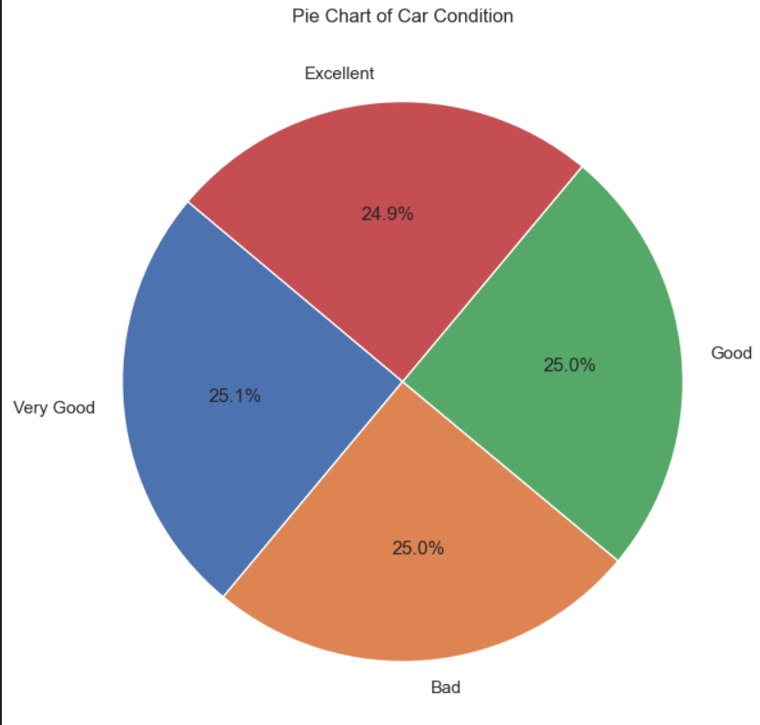
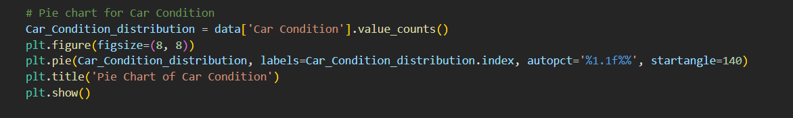
Analyzing categorical variables: (car condition)

Slide 20
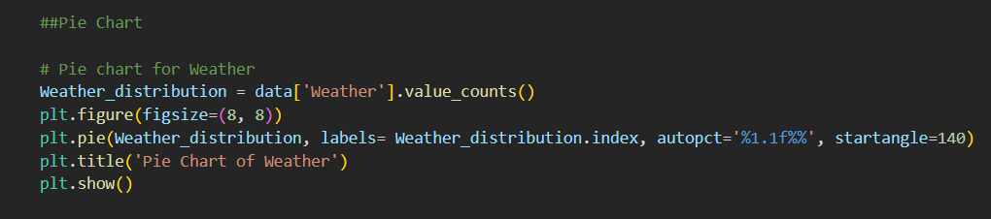
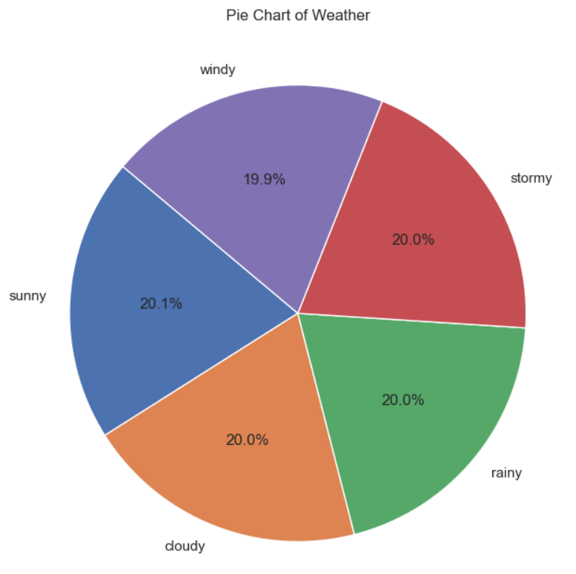
Analyzing categorical variables: (weather)

Slide 21
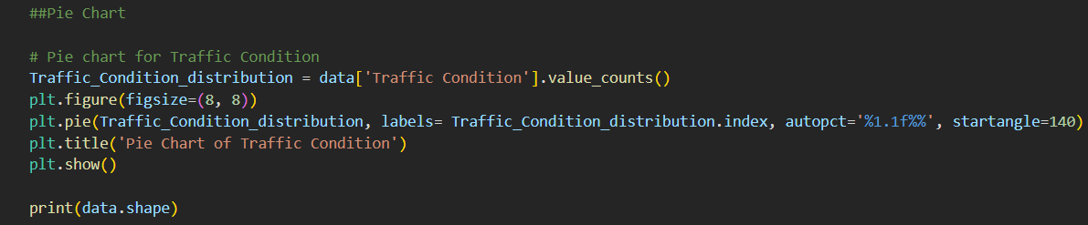
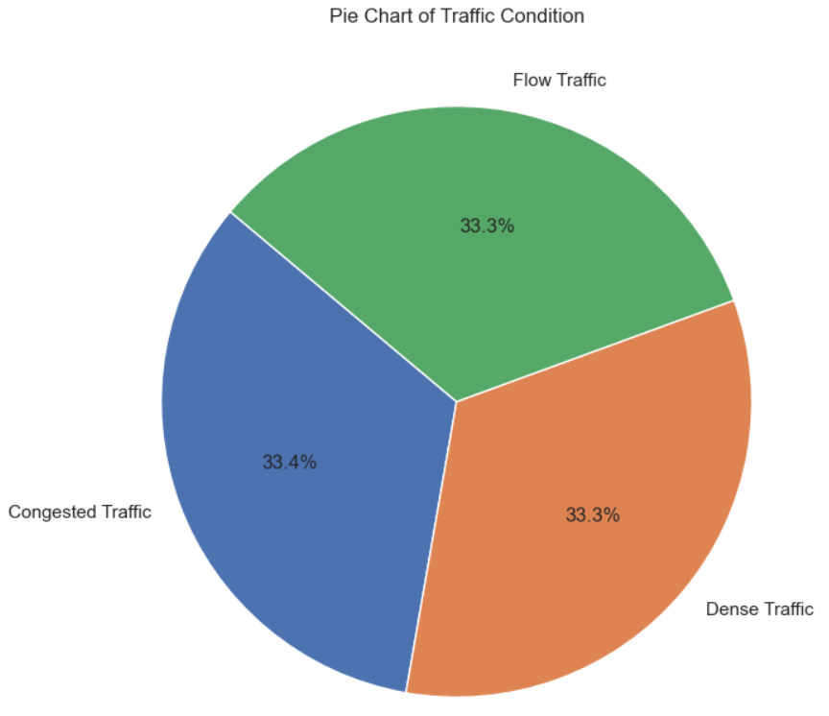
Analyzing categorical variables: (traffic condition)

Slide 22
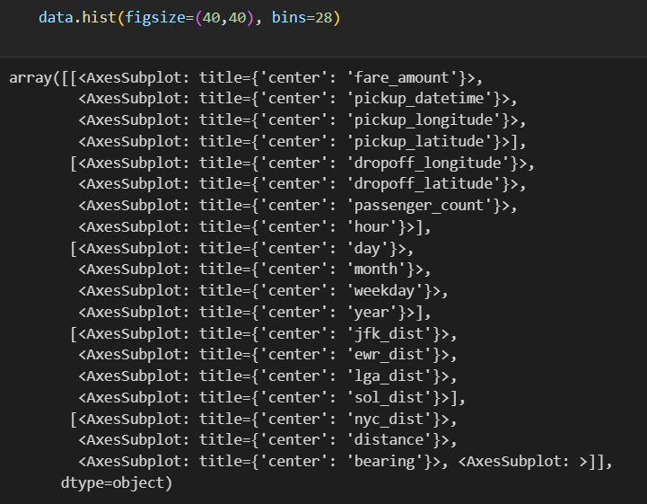
Plotting histograms and density plots for numerical columns

Slide 23
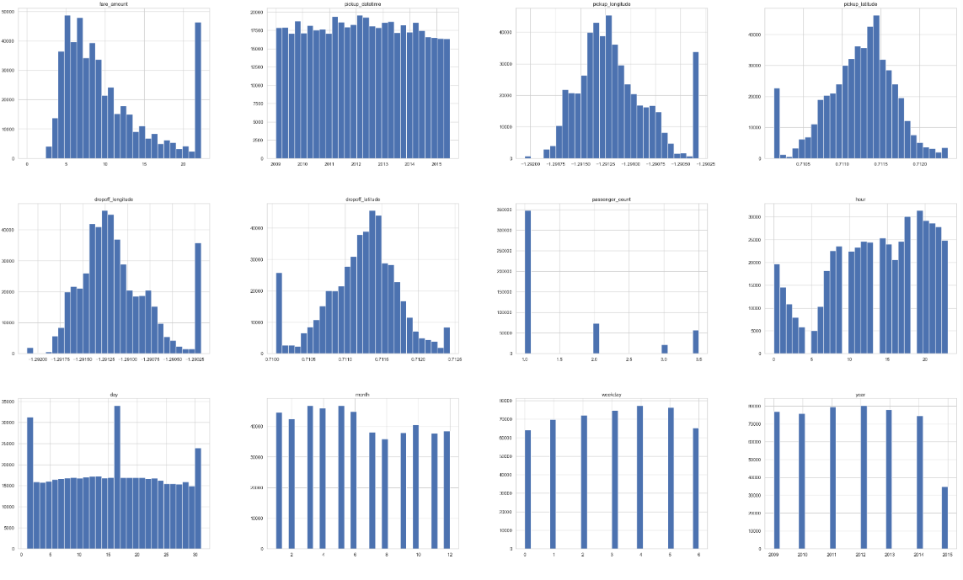
Plotting histograms and density plots for numerical columns(cont)

Slide 24
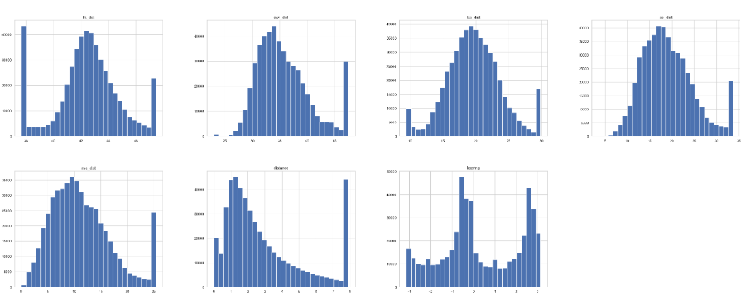
Plotting histograms and density plots for numerical columns(cont)

Slide 25
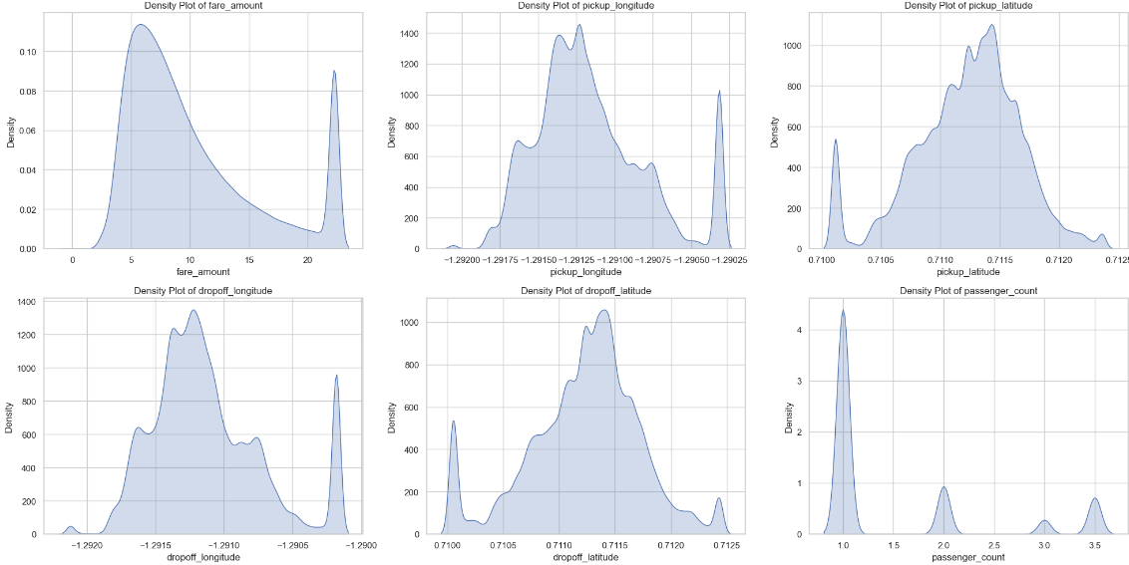
Plotting histograms and density plots for numerical columns(cont)

Slide 26
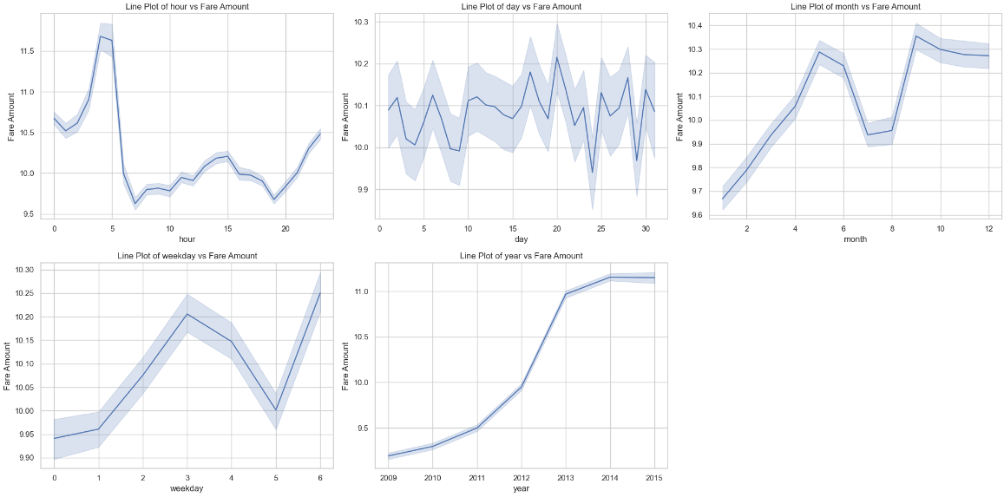
Lineplots for each time based col. Examining the avg fare amount over time

Slide 27
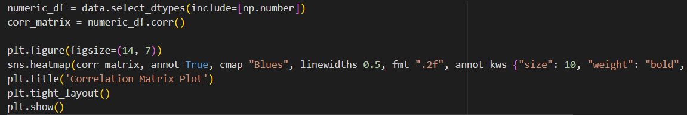
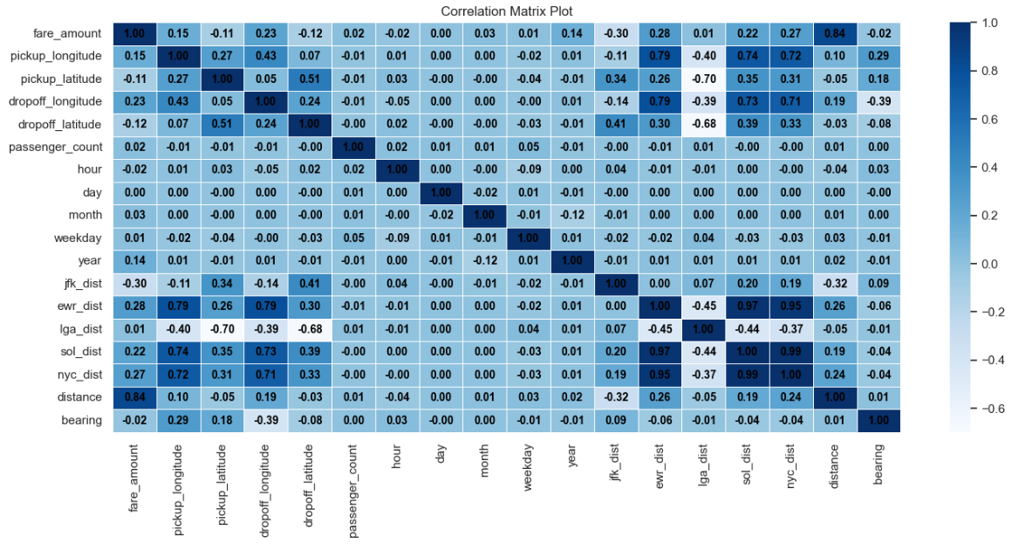

Slide 28
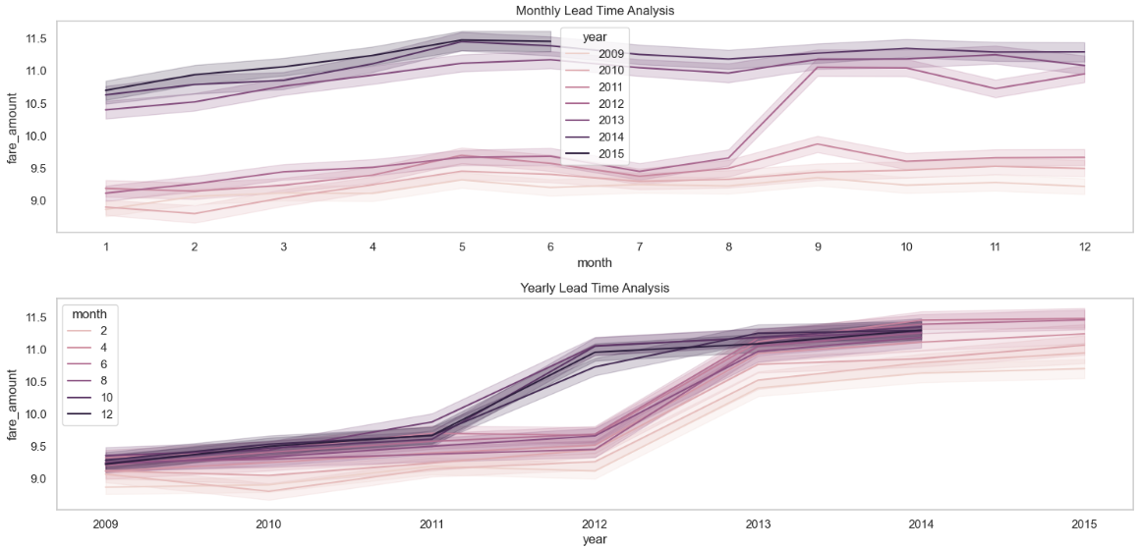
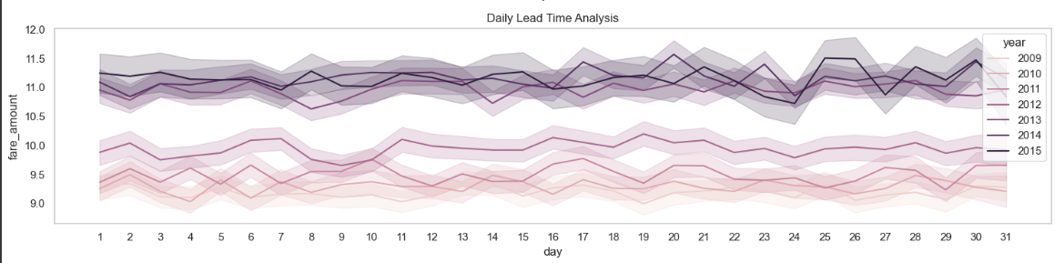

Slide 29
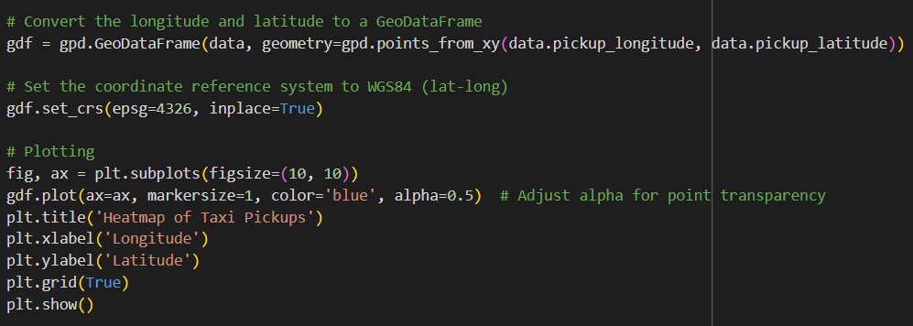
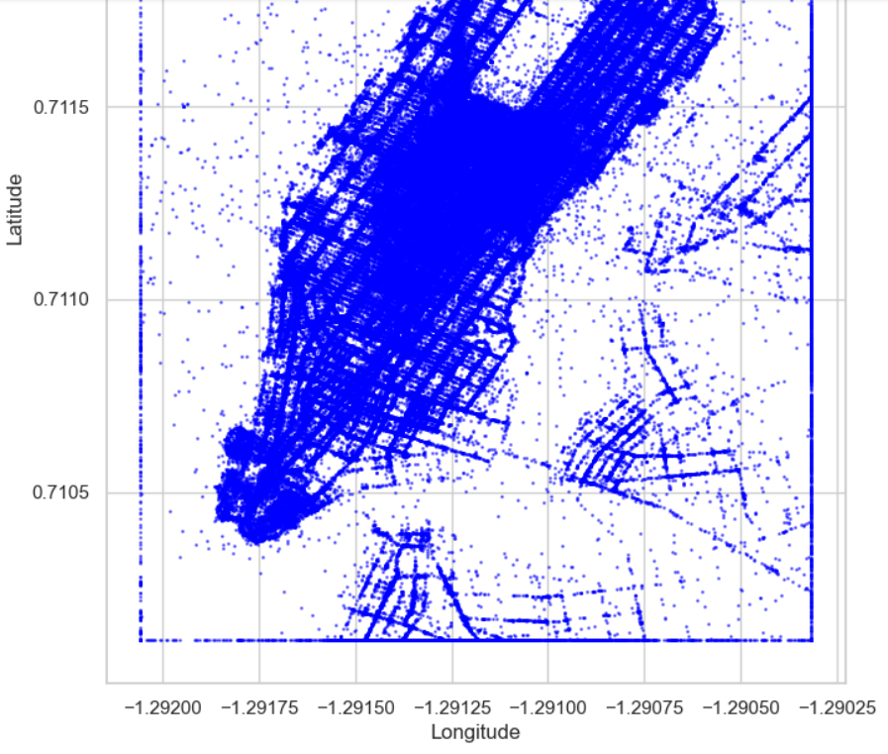
Heatmap of taxi pickups

Slide 30
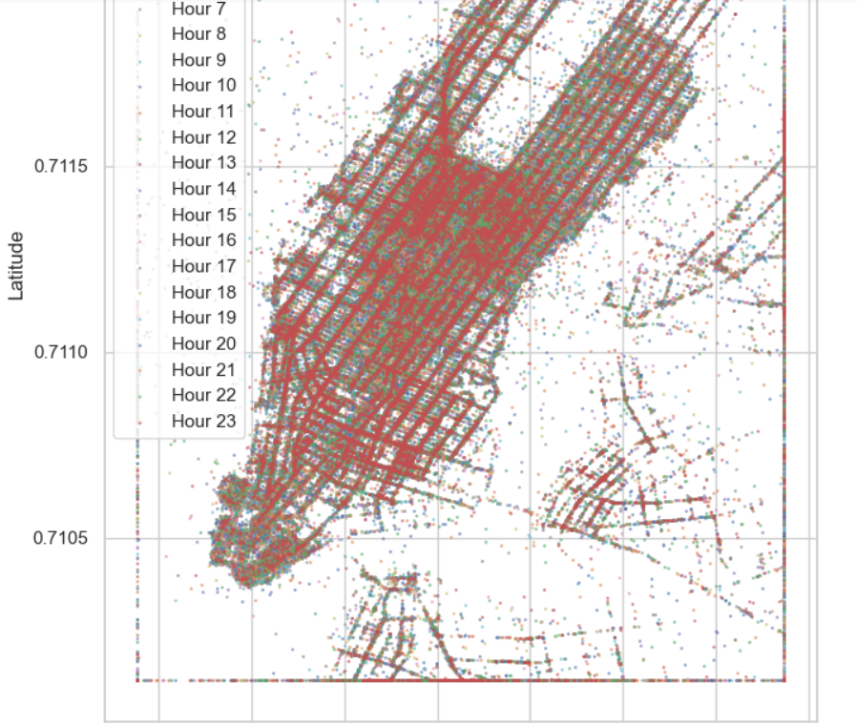
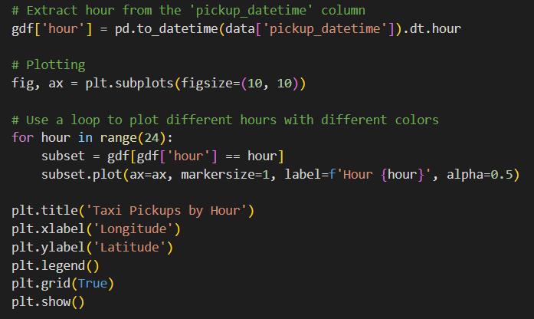
Taxi pickup by hour

Slide 31
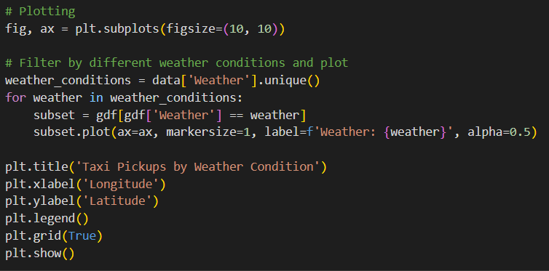
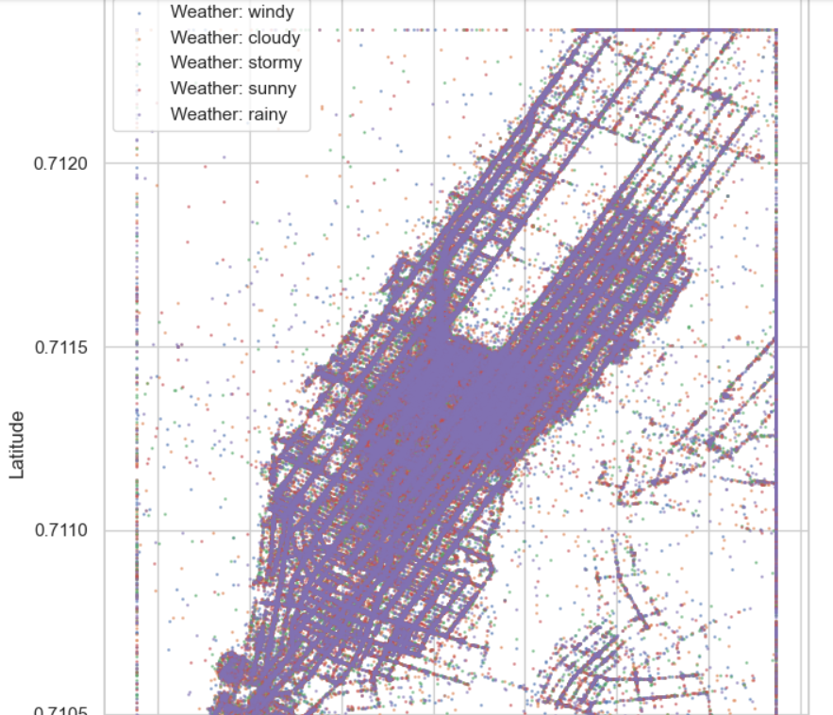
Taxi pickup by weather condition

Slide 32
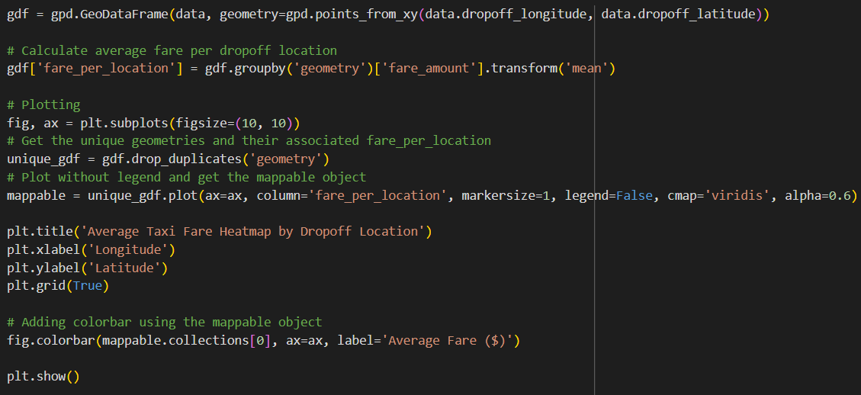
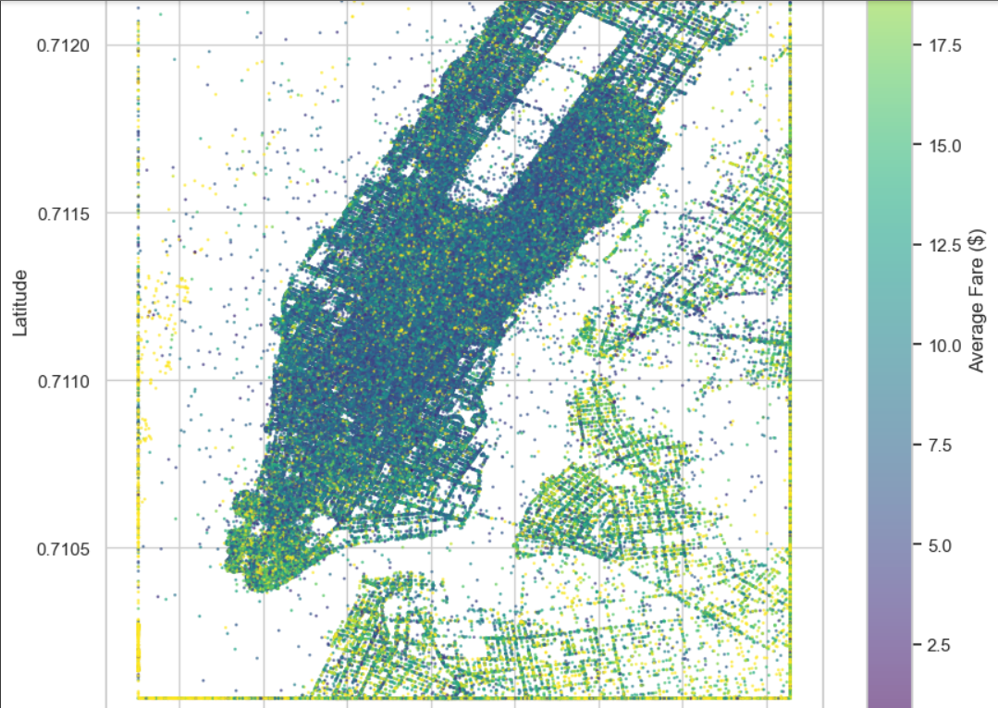
Average taxi fare heatmap by drop off loc.

Slide 33

THANK YOU

